Slide 1
PHP & MySql
PHP MySQL Introduction

Slide 2
MySQL is one of the most popular relational database system being used on the Web today. It is freely available and easy to install, however if you have installed Wampserver it already there on your machine.
MySQL is easy to use, yet extremely powerful, fast, secure, and scalable.
MySQL runs on a wide range of operating systems, including UNIX or Linux, Microsoft Windows, Apple Mac OS X, and others.
MySQL supports standard SQL (Structured Query Language).
MySQL is ideal database solution for both small and large applications.
MySQL is developed, and distributed by Oracle Corporation.
MySQL includes data security layers that protect sensitive data from intruders.
MySQL database stores data into tables like other relational database. A table is a collection of related data, and it is divided into rows and columns.

Slide 3
SQL, the Structured Query Language, is a simple, standardized language for communicating with relational databases like MySQL. With SQL you can perform any database-related task, such as creating databases and tables, saving data in database tables, query a database for specific records, deleting and updating data in databases.
SELECT email FROM persons WHERE first_name=“Raj"
PHP Connect to MySQL Server
Connect to the MySQL database server. PHP offers two different ways to connect to MySQL server: MySQLi (Improved MySQL) and PDO (PHP Data Objects) extensions.
Tip: The PHP's MySQLi extension provides both speed and feature benefits over the PDO extension, so it could be a better choice for MySQL-specific projects.

Slide 4
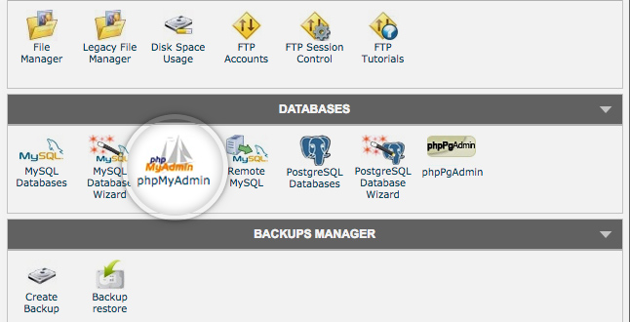
What is phpMyAdmin?
phpMyAdmin is one of the most popular applications for MySQL database management. It is a free tool written in PHP. Through this software you can create, alter, drop, delete, import and export MySQL database tables. You can run MySQL queries, optimize, repair and check tables, change collation and execute other database management commands.

Slide 5
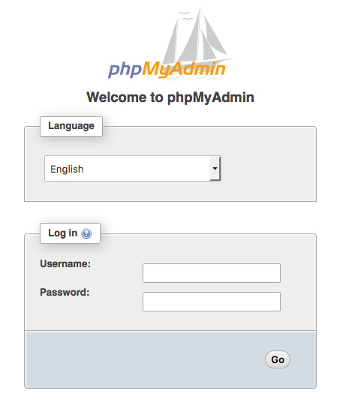

Slide 6
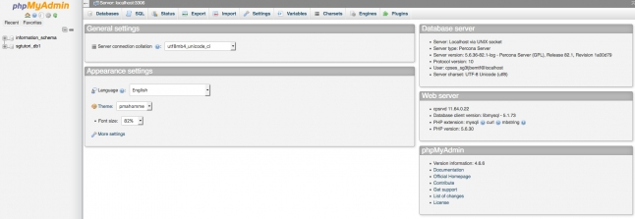
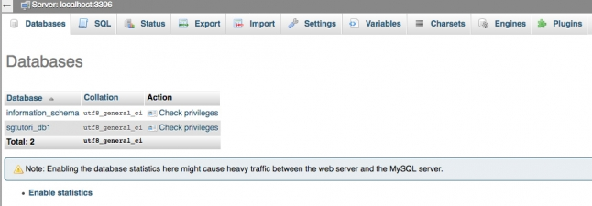

Slide 7
Syntax: MySQLi, Procedural way
$link = mysqli_connect("hostname", "username", "password", "database");
<?php
/* Attempt MySQL server connection. Assuming you are running MySQL
server with default setting (user 'root' with no password) */
$link = mysqli_connect("localhost", "root", "");
// Check connection
if($link === false){
die("ERROR: Could not connect. " . mysqli_connect_error());
}
// Print host information
echo "Connect Successfully. Host info: " . mysqli_get_host_info($link);
?>

Slide 8
Config.php
<?php
$host = "localhost";
$user = "root";
$password = '';
$db_name = “users";
$con = mysqli_connect($host, $user, $password, $db_name);
if(mysqli_connect_errno()) {
die("Failed to connect with MySQL: ". mysqli_connect_error());
}
?>

Slide 9
Checklogin.php
include "config.php";
$username = $_POST['user'];
$password = $_POST['pass'];
//to prevent from mysqli injection
$username = stripcslashes($username);
$password = stripcslashes($password);
$username = mysqli_real_escape_string($con, $username);
$password = mysqli_real_escape_string($con, $password);
$sql = "select *from login where username = '$username' and password = '$password'";
$result = mysqli_query($con, $sql);
$row = mysqli_fetch_array($result, MYSQLI_ASSOC);
$count = mysqli_num_rows($result);
if($count == 1){
echo "<h1><center> Login successful </center></h1>";
}
else{
echo "<h1> Login failed. Invalid username or password.</h1>";
}

Slide 10
<?php
include "config.php";
if(isset($_POST['but_submit'])){
$uname = mysqli_real_escape_string($con,$_POST['txt_uname']);
$password = mysqli_real_escape_string($con,$_POST['txt_pwd']);
if ($uname != "" && $password != ""){
$sql_query = "select count(*) as cntUser from users where username='".$uname."' and password='".$password."'";
$result = mysqli_query($con,$sql_query);
$row = mysqli_fetch_array($result);
$count = $row['cntUser'];
if($count > 0){
$_SESSION['uname'] = $uname;
header('Location: home.php');
}else{
echo "Invalid username and password";
}
}
}

Slide 11
<?php
include_once 'database.php';
$result = mysqli_query($conn,"SELECT * FROM myusers");
?>
<!DOCTYPE html>
<html>
<head>
<title> Retrive data</title>
</head>
<body>
<?php
if (mysqli_num_rows($result) > 0) {
?>
<table>
<tr>
<td>First Name</td>
<td>Last Name</td>
<td>City</td>
<td>Email id</td>
</tr>

Slide 12
<?php
$i=0;
while($row = mysqli_fetch_array($result)) {
?>
<tr>
<td><?php echo $row["first_name"]; ?></td>
<td><?php echo $row["last_name"]; ?></td>
<td><?php echo $row["city_name"]; ?></td>
<td><?php echo $row["email"]; ?></td>
</tr>
<?php
$i++;
}
?>
</table>
<?php
}
else{
echo "No result found";
}
?>
</body>
</html>

Slide 13
Insert Record
if(isset($_POST['save']))
{
$first_name = $_POST['first_name'];
$last_name = $_POST['last_name'];
$city_name = $_POST['city_name'];
$email = $_POST['email'];
$sql = "INSERT INTO employee (first_name,last_name,city_name,email)
VALUES ('$first_name','$last_name','$city_name','$email')";
if (mysqli_query($conn, $sql)) {
echo "New record created successfully !";
} else {
echo "Error: " . $sql . "
" . mysqli_error($conn);
}
mysqli_close($conn);
}

